Slide 1
FHIM Model Content Overview

Slide 2

Federal Health Information Model (FHIM) and Associated Terminology Models
Goal
Produce a logical, health information model that supports semantic interoperability and that is built by harmonizing information from the individual Federal partners and standards organizations
Principles
The model will be expressed in standard Unified Modeling Language (UML) notation
The model will be designed to meet all Federal partner semantic interoperability needs for the exchange of information with other organizations
The model will support existing national health standards
The model will be in the public domain, freely available and easy to access
The model will be specified as a logical model consisting of a set of domain models

Slide 3
Benefits of Information Modeling Project Information and Terminology Models
FHIM is a Platform Independent Model (PIM), expressed in standard UML
The modeling process harmonizes content (information and terminology) across organizations
The models are integrated (2-way links between Information and Terminology models)
The models support efficient standards development
Standard ballot materials can be generated from the FHIM
The models are being integrated with the Model Driven Health Tools (MDHT) to support a model-driven approach to development of information exchange interoperability specifications
FHIM maintains traceability to underlying standards - especially HL7, NCPDP, and X12 – as well as to S&I Initiatives
FHIM derivative models add “interoperability use cases”, which provide additional constraints. These derivative models maintain traceability to the use cases and to the HL7 EHR-S Functional Model
The models can be leveraged by organizations for internal use in systems and database development

Slide 4
Federal Health Information Model (FHIM) and Associated Terminology Models
The FHIM Terminology model is a UML model that defines code systems, concept domains and value sets
The Terminology model describes the underlying terminology constructs, including urls and version numbers so that software can be automatically generated to insure that implementations are conformant at run-time
The FHIM (logical, structural) model “binds to” (i.e., links to) the FHIM Terminology model using the same UML Profile that MDHT uses
The combination of the two FHIM models results in rigorous specifications against which conformance can be tested automatically

Slide 5
Model-driven Constraints in FHIM
Model-Driven Health Tools (MDHT) Examples

Slide 6
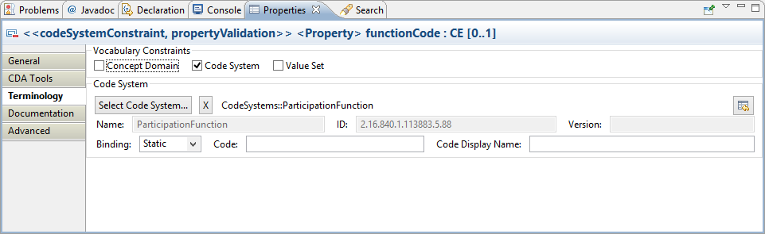
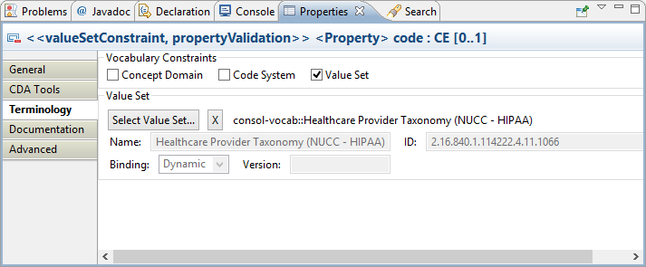
Code system vs. Value Set constraints

Slide 7
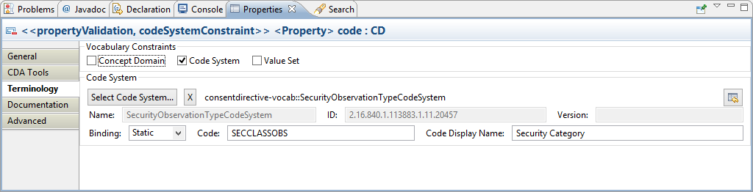
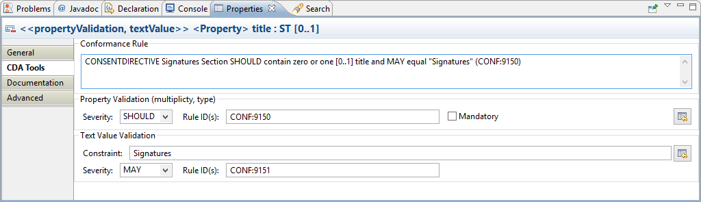
Fixed value constraints

Slide 8
Benefits of Model-Driven Approach
Analyze once implement many times
Maintain all your project constraints and improve them over time rather than starting “from scratch” if a new standard is needed
Consistent with FHIM/Federal Guidelines
Your IG model may be reused in the future for other interoperability standards IGs
Allows for transition from one information exchange format to another
E.g. HL7 Version 2 to FHIR

Slide 9
FHIM model instance examples
The following slides show examples of information modeled in the FHIM, including the vocabulary and metadata

Slide 10



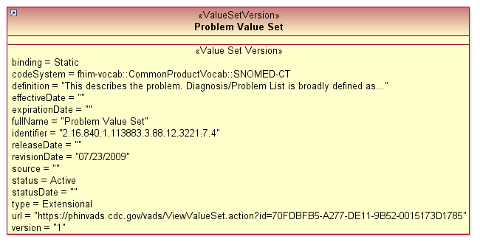

FHIM Problem List instance example
Note that the request was to show “problem date”; the
FHIM has several dates concerning problems (aka Health
Concerns), including date of onset, and date diagnosed. This model snippet assumes that “problem date” means date of
onset.

Slide 11


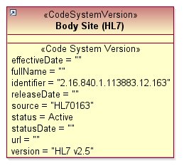
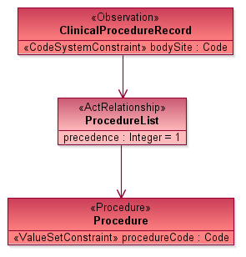


FHIM Procedure instance example

Slide 12

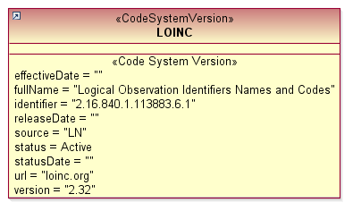
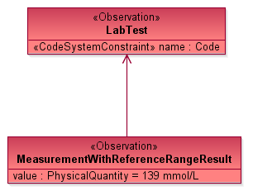
FHIM Lab test instance example

Slide 13
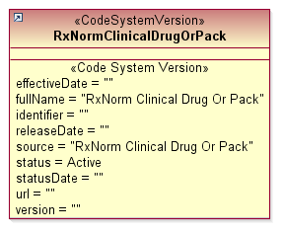

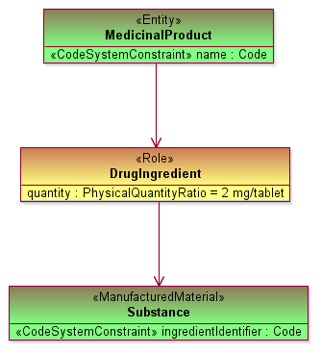
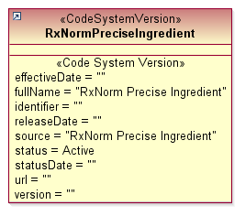

FHIM Medicinal Product instance example

Slide 14
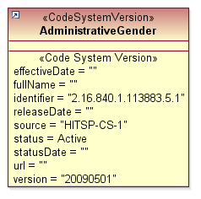


FHIM Demographics instance example

Slide 15
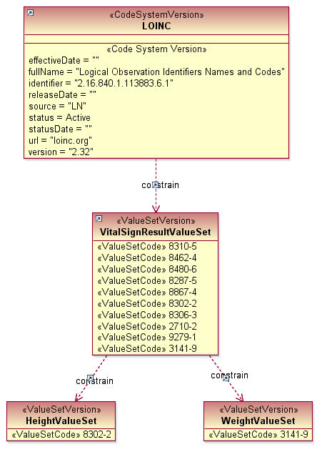
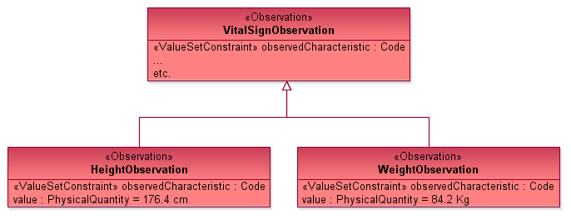


FHIM Vital Signs instance example
The FHIM includes “detailed clinical models” for certain common concepts, explicitly
showing first-class classes for each concept. It is important to note that after reaching a certain point in the model (VitalSignObservation, in this case), the detailed clinical
model classes could be *generated* from an ontology or a knowledge base

Slide 16
Conclusion
The FHIM contains all of the data elements requested
The FHIM unambiguously binds to the proper valuesets
The FHIM can link the UML concepts to a 11179 metadata registry (via UML stereotypes)
In fact, we could generate a 11179 registry from the FHIM
The FHIM plus MDHT enables generation of multiple kinds of artifacts, including interoperability specifications and code that developers can implement

